Slide 1
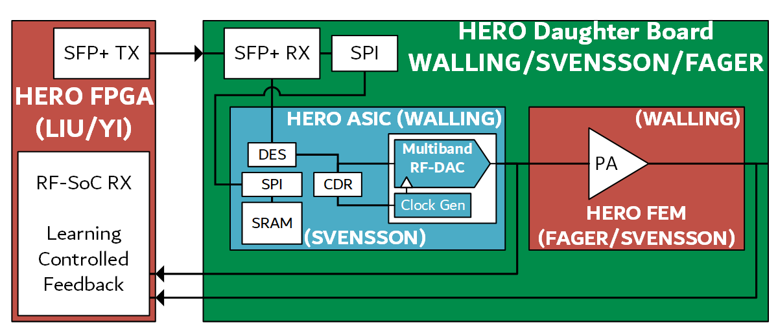


Track 1: High Efficiency Radio Over fiber (HERO) for 6G Networks and Beyond
The RF power amplifier is the largest energy consumer at the remote radio head. Moving next-G networks into FR3 (7–24 GHz) makes this worse: the band is shared with radar and satellite systems, so transmitters must be highly linear, while today's SDR radio units need extra frequency conversion and draw tens of watts before amplification.
Project Contributions
A2 · Energy Efficiency: Co-integrate multiband CMOS RF-DACs with wideband GaN PAs, driven straight from the optical fronthaul with no lossy up-conversion; target ≥ 25% efficiency at the radio head.
Low-jitter CDR clocking the RF-DAC from fiber
7–24 GHz reconfigurable RF-DAC
AI-synthesized GaN MMIC PAs
Real-time neuromorphic calibration
B1 · AI-Native Design: An FPGA neuromorphic engine (echo-state reservoir computing with federated learning) calibrates and linearizes the transmitter online; AI/ML also synthesizes the PA combiners.
Your Approach
Lead: Virginia Tech
Collaborative: Chalmers University of Technology
T1 Neuromorphic ML engine on RFSoC (Liu, Yi · VT)
T2 CMOS CDR and clocking (Svensson · Chalmers)
T3 Reconfigurable RF-DAC (Walling · VT)
T4 Wideband GaN front-end (Fager · Chalmers)
Silicon in Y1–Y2; dMIMO testbed demos in Y3.
The learning engine at the distributed unit tunes the clocks, RF-DAC and GaN PA over the same fiber that carries the data, so efficiency and linearity are optimized together, in real time.
Project website: https://github.com/noyades/NSF-VINES-HERO

